Slide 1







Final Presentation of IBM Data Analysis Capstone Project
Sophia J Zahra
May 6, 2024
https://github.com/SophiaJZ

Slide 2



OUTLINE
Executive Summary
Introduction
Methodology
Results
Discussion
Findings & Implications
Dashboard
Appendix
Discussion Overall Findings and Implications
Conclussion

Slide 3

EXECUTIVE SUMMARY
Introduction to Capstone Project, by understanding data scenario with following steps :
Explain the content of data.
What information want to be extracted from data.
What the techniques or methods are going to be used.
What tools environment (IDE) provided to support the conduct of data analysis.
Represent the importance or data findings using data visualization, generally depicts the insights with graph or chart.
Data documentation or story telling.

Slide 4

INTRODUCTION
On this capstone project, ”The 2019 Stack Overflow Developer Survey Results Are In”
dataset has been implemented in order to conduct data analysis.
Glance of the dataset:
Stack Overflow’s annual Developer Survey is the largest and most comprehensive survey of people who code around the world.
By the year of 2019, was marked the ninth-year they have published the annual Developer Survey with almost 90.000 developers took the 20 minutes survey earlier on that year.
Over half of respondents had written their first line of code by the time they were sixteen, although this experience varies by country and by gender.
The dataset contains 11552 rows and 85 columns.
The goal is to analyzes data to help identify future skill requirements by extract some important information from the dataset, such as:
What are the popular programming language and desired programming language used by developers.
What are top Databases and Platforms skills in demand.
The Demographics information of developers.
Presenting the essential information with Data visualization like Dashboard.
Dataset Source: https://stackoverflow.blog/2019/04/09/the-2019-stack-overflow-developer-survey-results-are-in

Slide 5

METHODOLOGY
Data Collection
It begun by scraping internet web sites and accessing APIs to collect data in various formats like .csv files, excel sheets, and databases.
Data Cleaning and Wrangling
Determine and Filling the missing values
Finding and Removing Duplicate values
Normalizing Data
Data Analysis
Distribution using mean, median
Outliers using quartile Q1, Q2, Q3
Correlation among all variables
Data Visualization
IBM Cognos Analytics Dashboard
IBM Cloud Dashboard

Slide 6
RESULTS
The Results will be presented in the next slides, the Bar chart showing the comparisons of the most popular programming languages and databases within the current year and for the next year.
The overall presentation will be depicted in the Dashboard that generated from IBM Cognos Analytics.

Slide 7
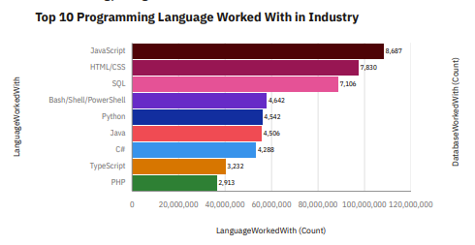
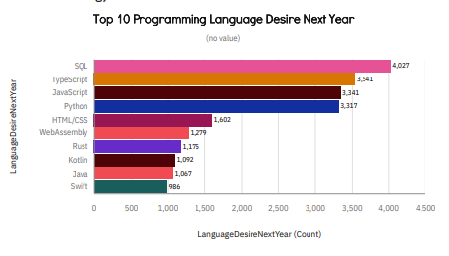
PROGRAMMING LANGUAGE TRENDS
Current Year
Next Year

Slide 8
PROGRAMMING LANGUAGE TRENDS - FINDINGS & IMPLICATIONS
Findings
The most popular Programming language in 2019 was on Javascript, followed by HTML/CSS and SQL.
The most desire Language for the next year fell on SQL, TypeScript and Javascript
SQL seems to be the fastest and famous desire language by developers in 2019.
Implications
Typescript language was growing very fast within a year, proven that it was in the nine-position in the current then became the second place for the next year.
Bash/Shell and PHP were excluded as the top ten language, possibly developers more interested in some other language like python, Rust and Kotlin.

Slide 9
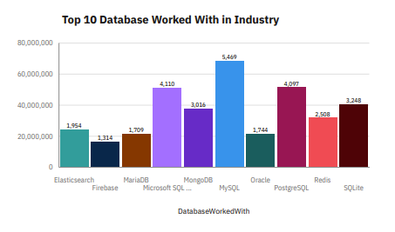
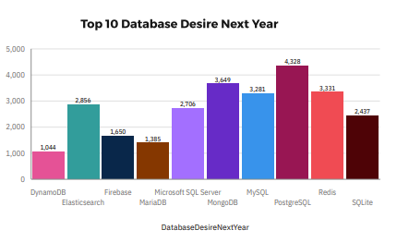
DATABASE TRENDS
Current Year
Next Year

Slide 10
DATABASE TRENDS - FINDINGS & IMPLICATIONS
Findings
The most popular Database in current year fell on MySQL, followed by SQL and PostgreSQL.
While the most popular Database for the next year fell on PostgreSQL, MongoDB and Redis.
Oracle became out of top 10 within a year and replace by DynamoDB.
Implications
SQL and MySQL seems a little bit loosing point in the market.
PostgreSQL accelerated those two another SQL and MySQL.
MongoDB took the second place in most popular database for the next year.

Slide 11

DASHBOARD
Here is my link for the “Stack-overflow-developer-survey-Dashboard-IBM-Cognos-Analytics”
https://github.com/SophiaJZ/Stack-overflow-developer-survey-Dashboard-IBM-Cognos-Analytics/blob/main/Building%20a%20Dashboard%20with%20IBM%20Cognos%20Analytics-Sophia.pdf

Slide 12
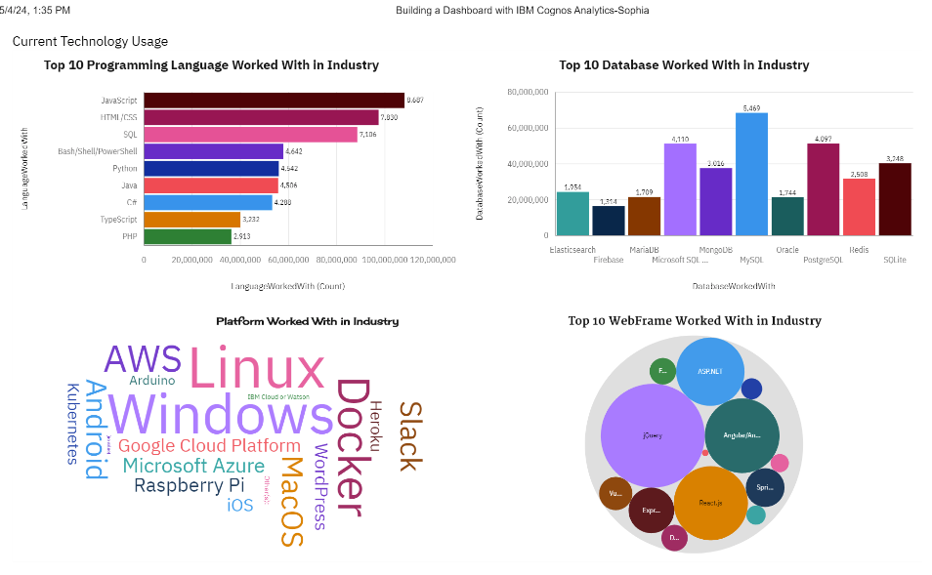
DASHBOARD TAB 1
Notes:
JavaScript has reached as the first place programming language and MySQL as the first place for popular Database in 2019.
While Windows and Linux always have the first place for the platform worked in Industry
Jquery was the best WebFrame used most in 2019 followed by React.js

Slide 13
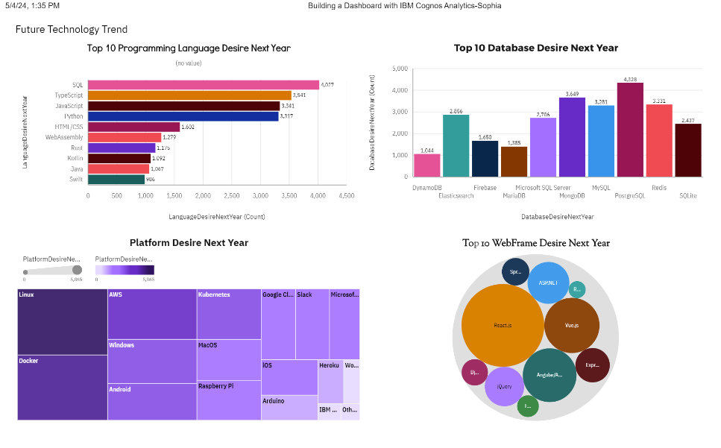
DASHBOARD TAB 2
Notes:
In the Future Technology Trend analysis, SQL was the most interest programming language followed by TypeScript and JavaScript
While PostgreSQL has replaced MySQL as the favorite Database in 2019
Linux took a first place for Platform desire next year followed by Docker and Windows
And React.js was the most popular WebFrame for Desire next Year

Slide 14
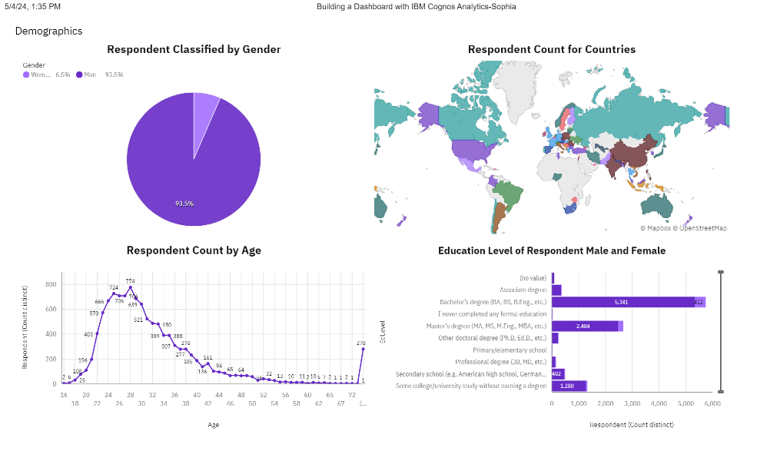
DASHBOARD TAB 3
Notes:
Based on the Respondent Classified by Gender Male and Female. Man Respondents almost took over the most user, it’s shown that man had 93.5 % and woman only had 6.5% portion.
While Respondent count by Age, mostly in the range of 20-40 ages active user.
Education level of Respondent widely from Bachelor’s degree (BA, BS, B.Eng, etc) and Master degree (MA, MS, M.Eng, MBA, etc).

Slide 15
Discussion Overall Findings and Implications
JavaScript has reached as the first place programming language and MySQL as the first place for popular Database in 2019.
While Windows and Linux always have the first place for the platform worked in Industry
Jquery was the best WebFrame used most in 2019 followed by React.js
In the Future Technology Trend analysis, SQL was the most interest programming language followed by TypeScript and JavaScript
While PostgreSQL has replaced MySQL as the favorite Database in 2019
Linux took a first place for Platform desire next year followed by Docker and Windows
And React.js was the most popular WebFrame for Desire next Year
Based on the Respondent Classified by Gender Male and Female. Man Respondents almost took over the most user, it’s shown that man had 93.5 % and woman only had 6.5% portion.
While Respondent count by Age, mostly in the range of 20-40 ages active user.
Education level of Respondent widely from Bachelor’s degree (BA, BS, B.Eng, etc) and Master degree (MA, MS, M.Eng, MBA, etc).

Slide 16

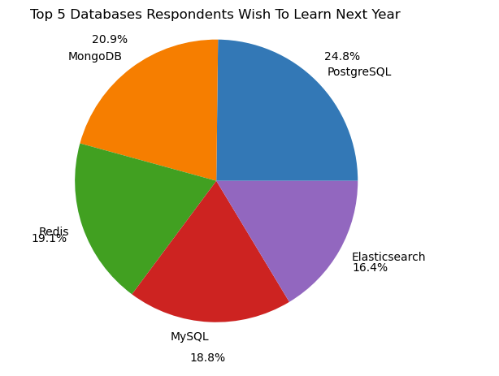
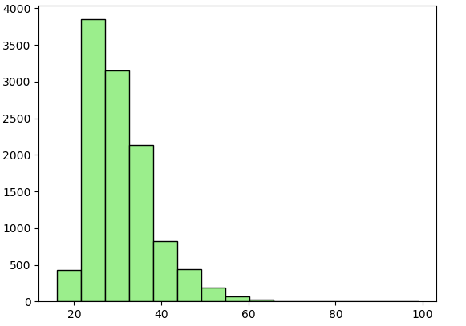
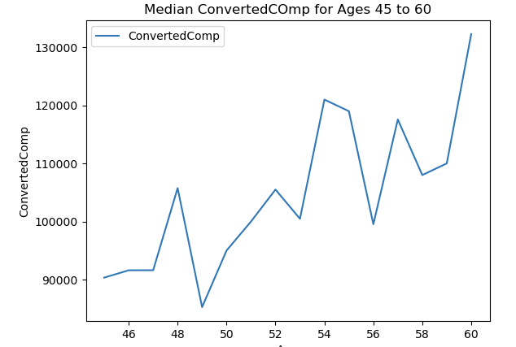
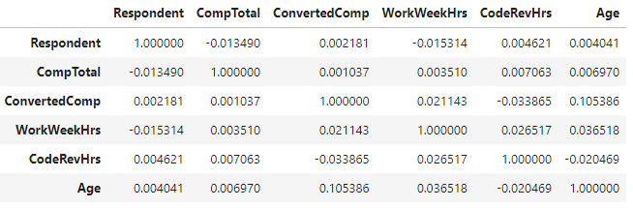
APPENDIX
Top 5 Databases desire next year
The histogram of Respondents Age between 20 – 70 age
The median COnvertedComp of respondents for ages 45-60
Data correlation between Age of respondents with other variables

Slide 17
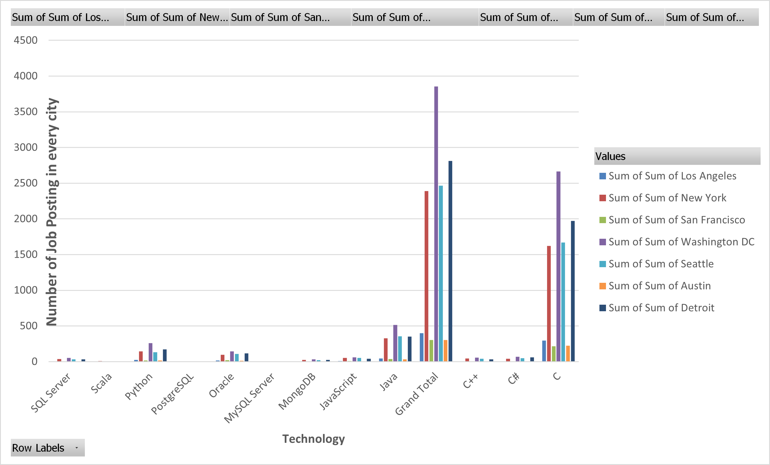
JOB POSTINGS
In Module 1 you have collected the job posting data using Job API in a file named “job-postings.xlsx”. Present that data using a bar chart here. Order the bar chart in the descending order of the number of job postings.

Slide 18
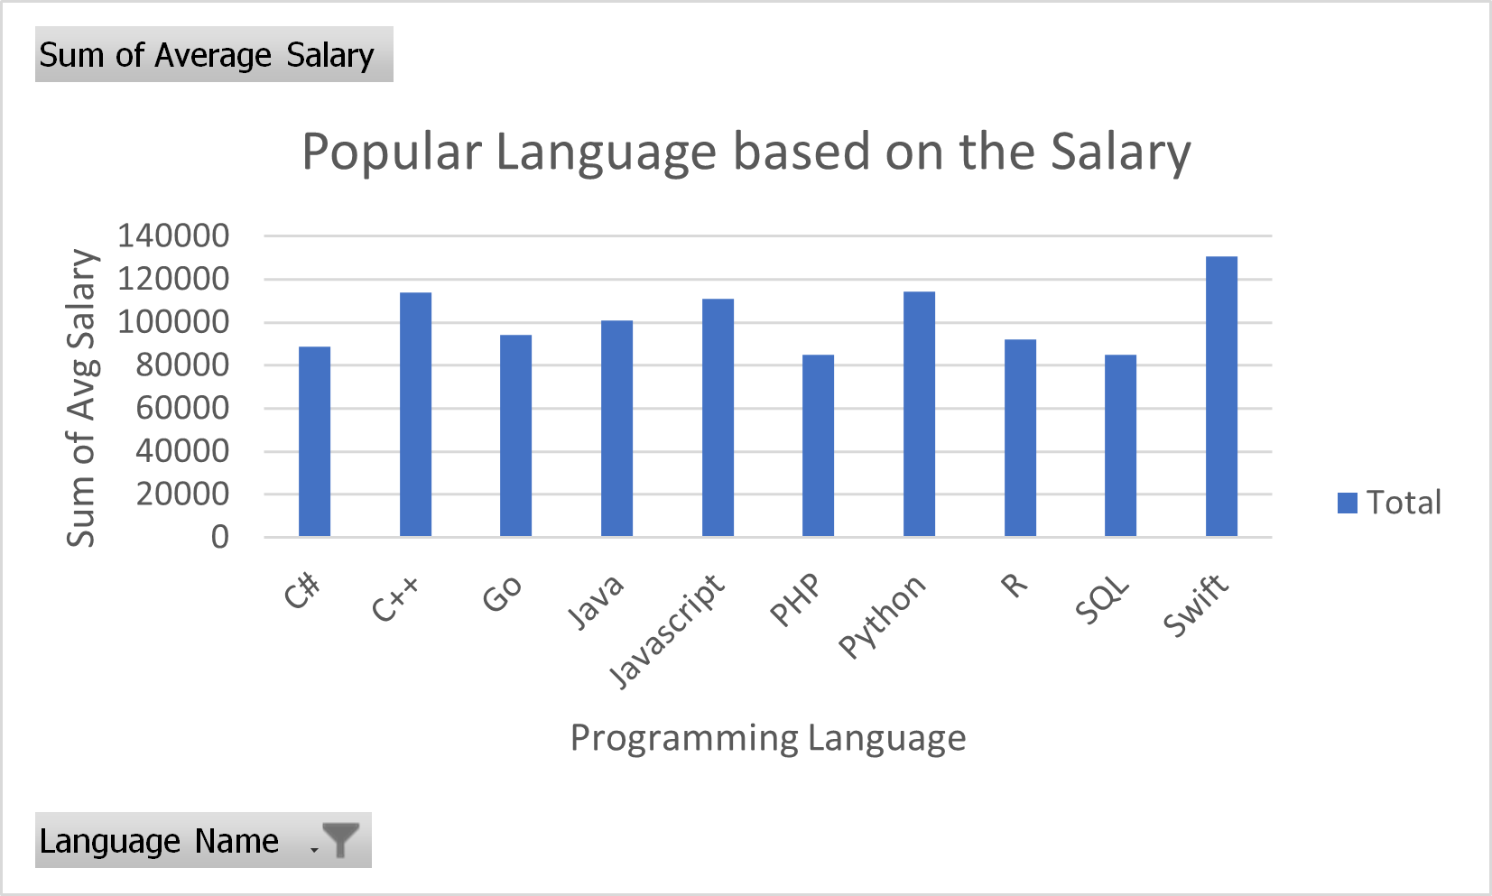
POPULAR LANGUAGES
In Module 1 you have collected the job postings data using web scraping in a file named “popular-languages.csv”. Present that data using a bar chart here. Order the bar chart in the descending order of salary.

Slide 19
CONCLUSION
I have accomplished IBM Data Analysis Capstone Project by following some methodologies started with pre-processing data which consists of Data collection and data cleaning then went through data analyzing to extract the insights and the information as needed. Presenting the results by chart and some graphs put all together onto a Dashboard as an easy virtual representation over the importance of data. By viewing the summary of the results is intended to get a better decision in order to predict the future values of a company or any businesses sector.

